Slide 1
Individual Level in Networks II
Centrality and Social Position

Slide 2
Levels of Analysis in social networks
Individual
1
Dyads
2
Triads
3
Cliques, Communities
4
Whole Network
5
The first part of the course follows this organization!

Slide 3
Levels of Analysis in social networks
Centrality
Individual
1
Dyads
2
Triads
3
Cliques, Communities
4
Whole Network
5
The first part of the course follows this organization!

Slide 4
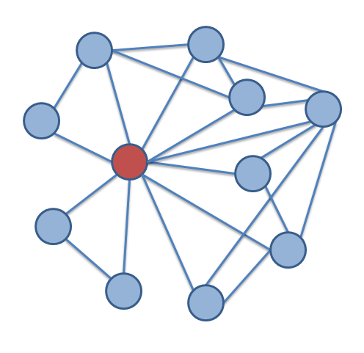
Centrality: What is it?
Central notion in network analysis
  However, ill-defined conceptually
  Intuitively, vertex-level index of prominence or importance
  Dozens and dozens of centrality have and continue to be proposed
Only agreement is that centrality is a individual-level construct
  Means that it is only defined for vertices

Slide 5
Centrality: What is it?
A lot of (sometimes inconsistent) substantive interpretations
  Autonomy
  Control
  Risk
  Exposure
  Influence
  Belongingness
  Brokerage
  Independence
  Power
  Strategic Location

Slide 6
Centrality: From network concepts to measures
Some notion of prominence, importance, brokerage, being “in the middle of things,” being in a favorable exchange position, etc.
Translate the concept from natural language to the “language” of graph theory to develop a graph-theoretic concept
(e.g. points and lines)
Link graph-theoretic concept to matrix algebra to develop a measure of originalconcept (e.g. matrix operations)
V₁
V₂
V₃
.
.
.
.
.
.
V_{n}
Result: A ranking of the nodes in the network based on centrality measure

Slide 7


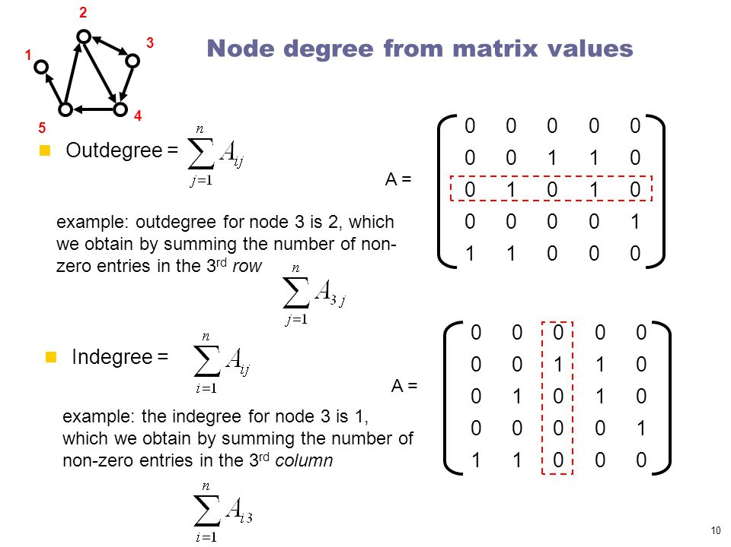
Degree C_{d}(v_{i})
Simplest (local) centrality measure to compute
Graph theory definition:
  Number of edges incident to a node
In undirected graphs:
  Given by either row or column sum vector of corresponding adjacency matrix
In directed graphs:
  Outdegree given by the row sum vector of corresponding adjacency matrix
Directed Graph
 | a | b | c | d | e
a | -- | 1 | 0 | 0 | 0
b | 1 | -- | 0 | 0 | 0
c | 0 | 1 | -- | 1 | 1
d | 0 | 0 | 0 | -- | 0
e | 0 | 0 | 1 | 1 | --
1
1
3
0
2

Slide 8
Degree C_{d}(v_{i})
Simplest (local) centrality measure to compute
Graph theory definition:
  Number of edges incident to a node
In undirected graphs:
  Given by either row or column sum vector of corresponding adjacency matrix
In directed graphs:
  Outdegree given by the row sum vector of corresponding adjacency matrix
Directed Graph
 | a | b | c | d | e
a | -- | 1 | 0 | 0 | 0
b | 1 | -- | 0 | 0 | 0
c | 0 | 1 | -- | 1 | 1
d | 0 | 0 | 0 | -- | 0
e | 0 | 0 | 1 | 1 | --
1
1
3
0
2

Slide 9
Degree C_{d}(v_{i})
Simplest (local) centrality measure to compute
Graph theory definition:
  Number of edges incident to a node
In undirected graphs:
  Given by either row or column sum vector of corresponding adjacency matrix
In directed graphs:
  Indegree given by the column sum vector of corresponding adjacency matrix
Directed Graph
 | a | b | c | d | e
a | -- | 1 | 0 | 0 | 0
b | 1 | -- | 0 | 0 | 0
c | 0 | 1 | -- | 1 | 1
d | 0 | 0 | 0 | -- | 0
e | 0 | 0 | 1 | 1 | --
1 | 2 | 1 | 2 | 1

Slide 10
Degree C_{d}(v_{i})
Simplest (local) centrality measure to compute
Graph theory definition:
  Number of edges incident to a node
In undirected graphs:
  Given by either row or column sum vector of corresponding adjacency matrix
In directed graphs:
  Indegree given by the column sum vector of corresponding adjacency matrix
Directed Graph
 | a | b | c | d | e
a | -- | 1 | 0 | 0 | 0
b | 1 | -- | 0 | 0 | 0
c | 0 | 1 | -- | 1 | 1
d | 0 | 0 | 0 | -- | 0
e | 0 | 0 | 1 | 1 | --
1 | 2 | 1 | 2 | 1

Slide 11
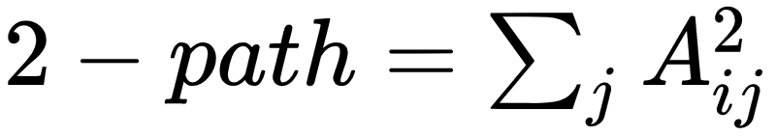
K-path centrality C_{k-path}(v_{i})
First proposed by Sade (1989)
  Social Network Concept: How many people is a person indirectly connected to?
  Graph theoretic concept: Sum of all paths of length k that have vertex v_{i} as their first element
  Matrix Procedure: Take the row sum of matrix A^{k}, where A^{k}_{ij} is the number of paths of length k from i to j
Generalization of degree centrality
  Degree centrality = 1-path centrality, since all entries in the adjacency matrix indicate a path of length 1 from i to j
 | a | b | c | d | e
a | -- | 0 | 0 | 0 | 0
b | 0 | -- | 0 | 0 | 0
c | 1 | 0 | -- | 0 | 1
d | 0 | 0 | 0 | -- | 0
e | 0 | 1 | 0 | 1 | --
0
0
2
0
2

Slide 12
K-path centrality C_{k-path}(v_{i})
First proposed by Sade (1989)
  Social Network Concept: How many people is a person indirectly connected to?
  Graph theoretic concept: Sum of all paths of length k that have vertex v_{i} as their first element
  Matrix Procedure: Take the row sum of matrix A^{k}, where A^{k}_{ij} is the number of paths of length k from i to j
Generalization of degree centrality
  Degree centrality = 1-path centrality, since all entries in the adjacency matrix indicate a path of length 1 from i to j
 | a | b | c | d | e
a | -- | 0 | 0 | 0 | 0
b | 0 | -- | 0 | 0 | 0
c | 1 | 0 | -- | 0 | 1
d | 0 | 0 | 0 | -- | 0
e | 0 | 1 | 0 | 1 | --
0
0
2
0
2

Slide 13
Types of centrality measures and interpretations
How well are nodes directly connected to others?
  Degree, indegree, outdegree
    Number of one-step connection from a node to all others
How well are nodes indirectly connected to others?
  K-path, closeness
    Number of paths of length k, or shortest paths from a node to all others
How well are nodes set as intermediaries between other nodes?
  Betweenness
    Prop. of shortest paths between all pairs of nodes including the focal node
How well are nodes set as influential of highly connected others?
  Eigenvector
    Node centrality is the average of the centrality of the other nodes they are directly and indirectly connected to

Slide 14
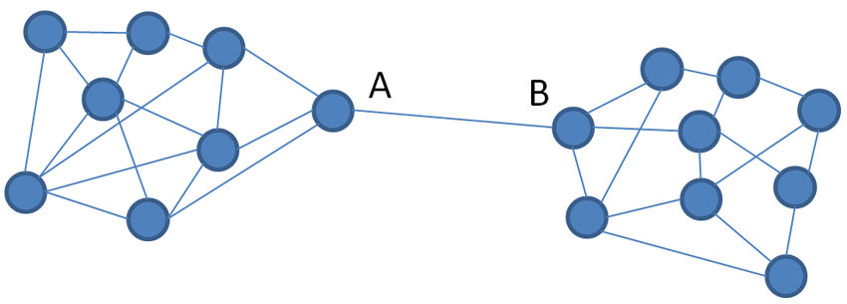
Betweenness C_{between}(v_{i})
First proposed by Freeman (1977)
  Social Network Concept: What share of the entire network flow goes through a given person?
  Graph theoretic concept: Sum of of the proportion of shortest paths in the graph between all other pairs of vertices {v_{j}, v_{k}} that contain v_{i}
C
E
D

Slide 15
Betweenness C_{between}(v_{i})
First proposed by Freeman (1977)
  Social Network Concept: What share of the entire network flow goes through a given person?
  Graph theoretic concept: Sum of of the proportion of shortest paths in the graph between all other pairs of vertices {v_{j}, v_{k}} that contain v_{i}
C
E
D

Slide 16
Betweenness C_{between}(v_{i})
First proposed by Freeman (1977)
  Social Network Concept: What share of the entire network flow goes through a given person?
  Graph theoretic concept: Sum of of the proportion of shortest paths in the graph between all other pairs of vertices {v_{j}, v_{k}} that contain v_{i}
C
E
The shortest path between A and C includes B!
D

Slide 17
Betweenness C_{between}(v_{i})
First proposed by Freeman (1977)
  Social Network Concept: What share of the entire network flow goes through a given person?
  Graph theoretic concept: Sum of of the proportion of shortest paths in the graph between all other pairs of vertices {v_{j}, v_{k}} that contain v_{i}
C
E
The shortest path between A and D also includes B!
D

Slide 18
Betweenness C_{between}(v_{i})
First proposed by Freeman (1977)
  Social Network Concept: What share of the entire network flow goes through a given person?
  Graph theoretic concept: Sum of of the proportion of shortest paths in the graph between all other pairs of vertices {v_{j}, v_{k}} that contain v_{i}
C
E
The shortest path between A and E includes both B and C!
D

Slide 19
Betweenness C_{between}(v_{i})
First proposed by Freeman (1977)
  Social Network Concept: What share of the entire network flow goes through a given person?
  Graph theoretic concept: Sum of of the proportion of shortest paths in the graph between all other pairs of vertices {v_{j}, v_{k}} that contain v_{i}
High betweenness actors can “broker” between different people
C
E
The shortest path between A and E includes both B and C!
D

Slide 20
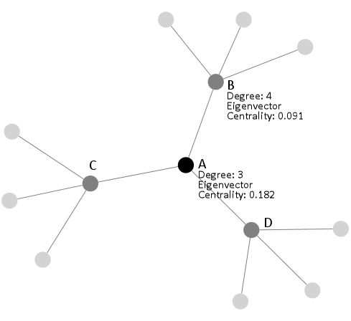
Eigenvector Centrality
Basic idea: A vertex is more central, the more central its neighbors are
With Degree Centrality, each alter carries equal weight
  What if a person has friends who have lots of other friends versus a person whose friends have few friends?
Solution:
  Give each vertex more “centrality points” when for links to central people!

Slide 21
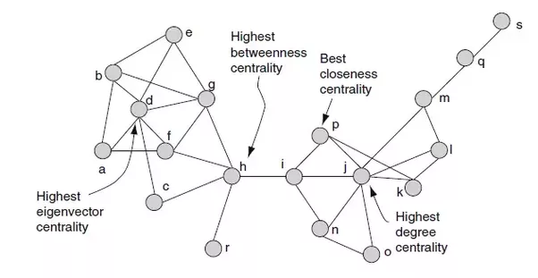
Eigenvector Centrality C_{eigen}(v_{i})

Slide 22
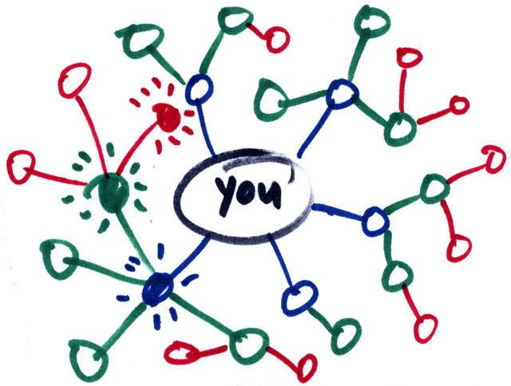
What is social capital?
Social capital:
  Benefits accrued as the result of your connections
    People who are better connected do better
What can you get from your connections?
  Some benefits comes from strong, dense networks:
    Social and emotional support
      Trusting somebody with an intimate secret
    Companionship
      Having somebody to hang out with
    Material support
      knowing where to go in a time of need

Slide 23
What is social capital?
Social capital:
  Benefits accrued as the result of your connections
    People who are better connected do better
What can you get from your connections?
  Some benefits come weakly connected, diverse networks:
    Novel information
      Finding out about things that your close contacts might not know
    New or cutting edge ideas
      Combining different ideas into a new idea
    New people
      Being introduced to people who can help

Slide 24
What is social capital?
What you get from your connections depends on how you are connected to others
  Two arguments:
    Social capital as closure (Coleman 1990)
      Having a core group of intimate friends who also know one another
    Social capital as brokerage (Burt 2005: 4)
      “Advantage created by a person’s location in a structure of relations”
  Which one is the better form of capital?
    Depends on what you want!
Here we will focus on the second:
  Social capital from being a connector (or being connected to people who connect) between different worlds

Slide 25
Granovetter’s strength of weak ties theory
Concept:
  Granovetter-transitivity (g-transitivity)
    Rule 1: if two people are strongly connected they are likely to have a lot of other friends in common
A
B
Strong Tie

Slide 26
Granovetter’s strength of weak ties theory
Concept:
  Granovetter-transitivity (g-transitivity)
    Rule 1: if two people are strongly connected:
      They are likely to have a lot of other friends in common
    Rule 2: if A and B have a strong tie and B and C have a strong tie:
      There should be at least a weak tie between A and C
Good probability of
existing tie!
C
Strong Tie
A
B
Strong Tie

Slide 27
Granovetter’s strength of weak ties theory
Concept:
  Granovetter-transitivity (g-transitivity)
    Rule 1: if two people are strongly connected:
      They are likely to have a lot of other friends in common
    Rule 2: if A and B have a strong tie and B and C have a strong tie:
      There should be at least a weak tie between A and C
  Reasons for g-transitivity:
    Demographic similarity (homophily)
    Shared foci
    Propinquity
C
At least a little similar
Similar
A
B
Similar

Slide 28
Granovetter’s strength of weak ties theory
Concept:
  Granovetter’s weak tie principle:
    Weak ties allow for a violation of g-transitivity
    You don’t have to be connected to the people who are connected to the people whom you only have a weak tie connection to
Good probability of
no tie!
C
Strong Tie
A
B
Weak Tie

Slide 29
Strength of weak ties theory
Application of the g-transitivity principle to ego-network layers:
  G-transitivity more likely to apply to strong ties in your support clique and sympathy group
Implication:
  Weak ties in you active network less likely to be connected to one another
G-transitive ties
G-transitivity violations

Slide 30
Strength of weak ties theory
Application of the g-transitivity principle to ego-network layers:
  Weak ties can function as bridges to parts of social structure to which you wouldn’t have access
Implication:
  Absent weak ties:
    You will not have access to distant parts of the social system
    Information will tend to be local
    Will put you at a disadvantage when novel information is valuable

Slide 31
Strength of weak ties theory
People who may know something your close friends don’t know
Application of the g-transitivity principle to ego-network layers:
  Weak ties can function as bridges to parts of social structure to which you wouldn’t have access
Implication:
  Absent weak ties:
    You will not have access to distant parts of the social system
    Information will tend to be local
    Will put you at a disadvantage when novel information is valuable
Broker
Bridging tie

Slide 32
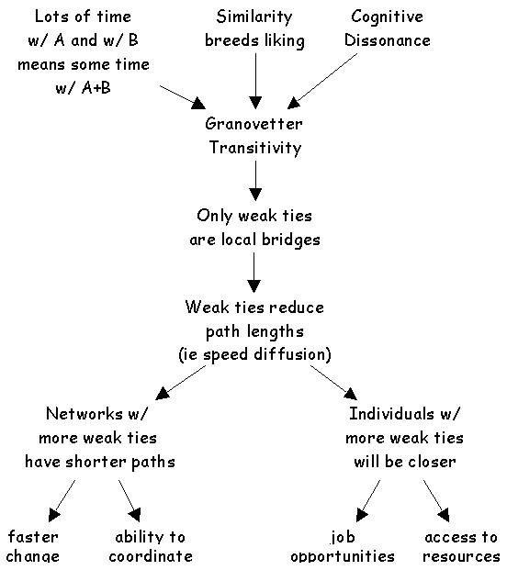
Application: Getting a job
If social mobility (e.g. finding new job opportunities) depends on (new) information access:
  Then having weak ties will be correlated with mobility and other forms of success
  Contacts with whom you are weakly connected will be more likely to know something you don’t know
  Weak ties help you insofar as they connect you to others with access to both information and resources

Slide 33
Structural holes theory
People who may know something your close friends don’t know
Strength of weak ties theory is a theory about how you can connect to brokers by developing bridging ties
  It is a theory of social capital as information access
But note that here the powerful person is the broker not you
  She controls the information
What if you want to be the broker in control?
Broker
Bridging tie

Slide 34
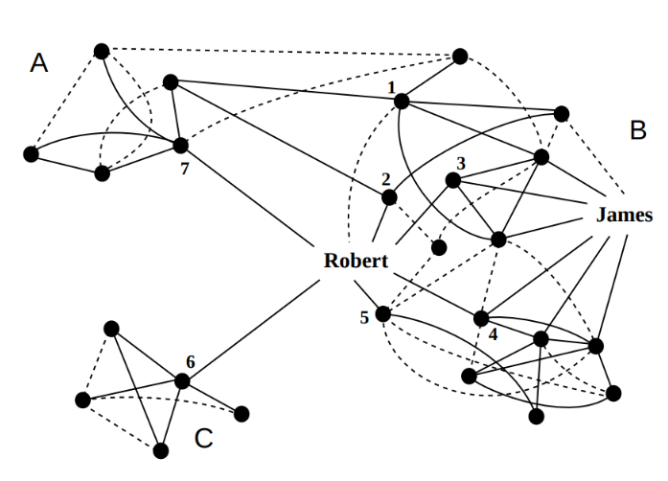
Structural holes theory
Structural holes theory is a theory about how to configure your network so that you control the information:
  Others depend on you for access
  You maximize social capital when you occupy a position “in between” others:
    Violations of g-transitivity create “holes” in social structure
  Who has the most social capital?
    James or Robert?

Slide 35
Structural holes theory
Structural holes in networks provide two kinds of benefits:
  Passive exposure effect:
    You get to know what other people know (a la Granovetter)
  Active control effect (Burt 1995):
    You decide whether some people know some things or not
    You shape the way other people perceive others
    You can play people against one another

Slide 36
Structural holes theory
Structural holes rich networks provide two kinds of benefits:
  Passive exposure effect:
    You get to know what other people know (a la Granovetter)
  Active control effect (Burt 1995):
    You are less bound by the norms and expectations of any one group
    You are free to move across the social structure
      Be different things to different people

Slide 37
Structural holes theory
The opposite of having structural holes is what Burt calls Network Constraint
  In a high constraint network:
    Your contacts are connected to one another
    You are subject to the strong expectations of a single group
    You depend on others for information access

Slide 38
Ego networks: Clustering Coefficient
a
b
a
b
a
b
Ego
Ego
Ego
c
d
c
d
c
d
 | a | b | c | d
a | -- | 0 | 0 | 0
b | 0 | -- | 0 | 0
c | 0 | 0 | -- | 0
d | 0 | 0 | 0 | --
 | a | b | c | d
a | -- | 1 | 1 | 0
b | 1 | -- | 0 | 0
c | 1 | 0 | -- | 1
d | 0 | 0 | 1 | --
 | a | b | c | d
a | -- | 1 | 1 | 1
b | 1 | -- | 1 | 1
c | 1 | 1 | -- | 1
d | 1 | 1 | 1 | --
CC_{ego}= 0
CC_{ego}= 0.5
CC_{ego}= 1.0
Unclustered
Clustered

Slide 39
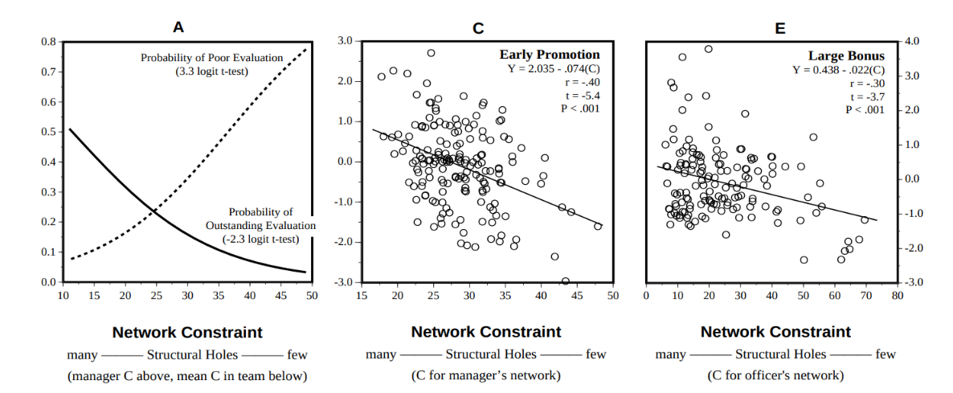
Structural holes theory
Evidence for structural holes argument (Burt 2005):
  In corporate settings people who have networks rich in structural holes (low constraint):
    Receive higher salaries
    Get promoted faster
    Receive better performance evaluations

Slide 40
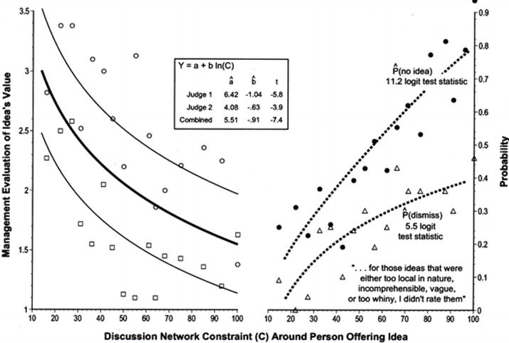
Structural holes theory
Why do people located in between structural holes do better?
  They have better ideas (Burt 2005)
Why do they have better ideas?
  They can combine elements from different sources to create novel combinations

